Slide 1
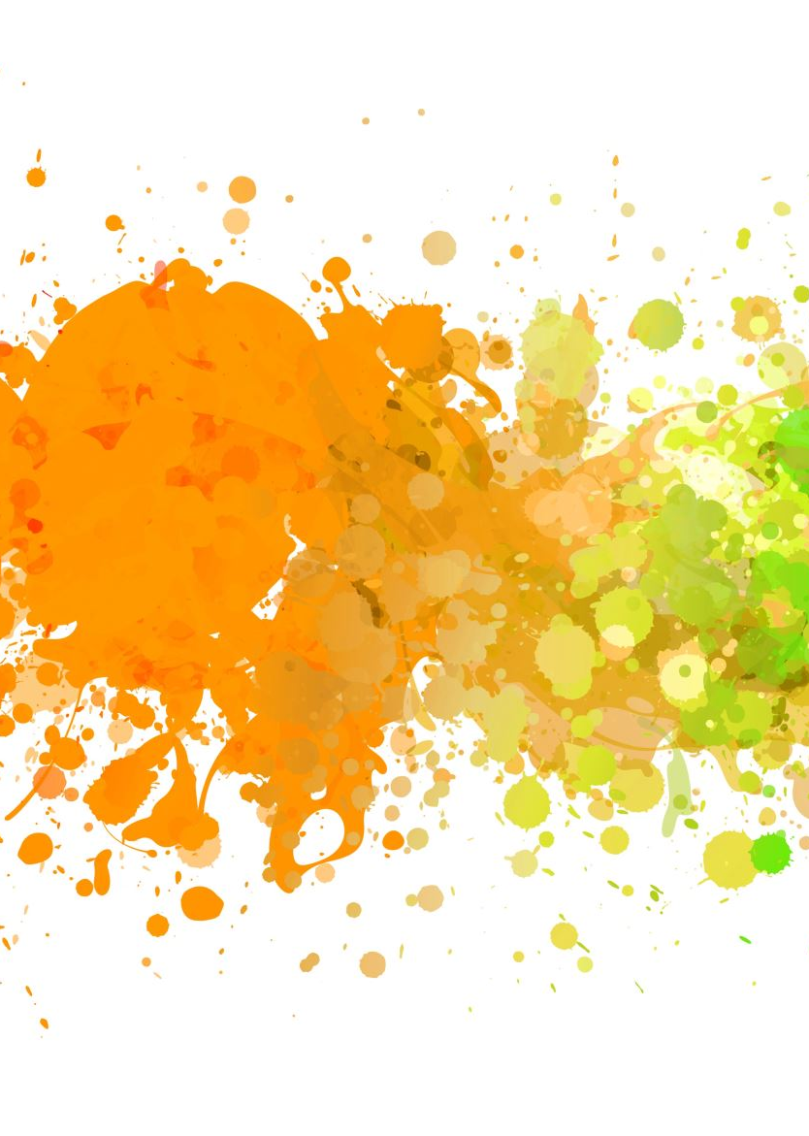
The Future of Precision Medicine: Mayo Clinic’s AI Evolution
Moving from Predictive Analytics to Agentic Clinical Systems
By: Jesus Chavez

Slide 2
Case Study Selection
Organization: Mayo Clinic Platform (MCP).
Mayo has transitioned from a hospital system to a “Global AI Ecosystem.”
Recently announced a strategic R&D collaboration with Merck to use multimodal AI for drug discovery.

Slide 3
Description of the Technology
Multimodal Foundation Models: AI that simultaneously processes genomics, pathology slides, and unstructured clinical notes.
Agentic AI: Unlike traditional AI, these "agents" can execute multi-step workflows—such as autonomously identifying a high-risk patient, drafting a referral, and flagging evidence gaps for regulatory submissions.
Virtual Cell Technologies: Computer-based models that simulate cellular behavior to predict drug efficacy before human trials.

Slide 4
Implementation
Data Behind Glass: A privacy-preserving environment where external partners access de-identified data without the data ever leaving Mayo’s secure cloud.
Ambient Clinical Listening: Implementation of AI that listens to patient encounters, auto-populates EHRs to reduce clinical burnout by 40%.
Solution Orchestrator: Deploying qualified AI models instantly across its global network of 70+ partner hospitals.

Slide 5
Key Benefits & Improvements
Disease Interception: AI now identifies risks for pancreatic cancer and heart failure up to 5 years before symptoms appear.
Drug Discovery: The Merck partnership aims to accelerate treatment for multiple sclerosis and inflammatory bowel disease by identifying biologically defined patient subgroups.
Storke Care: Real-world data from the connected network has expanded life-saving stroke protocols to rural Missouri and international sites like Bazil and Israel.

Slide 6
Implementation Challenges
Algorithmic Hallucinations: LLMs sometimes fabricate medical citations, requiring a strict verification process.
Data Heterogeneity: Combining data from one hospital with another requires massive efforts in data standardization.
The “Trust Gap”: Older clinicians often resist AI-driven interventions that contradict traditional diagnostic heuristics.

Slide 7
Ethical & Philosophical Implications
Justice: Will high-end AI only be for those who can afford Mayo-tier healthcare?
Autonomy vs. Paternalism: If an AI “agent” chooses a treatment path, is the patient truly giving informed consent if the logic is a black box?
Philosophical lens:
Utilitarianism: Is a 1% error rate in AI acceptable if it reduces overall medical errors by 50%?
Virtue Ethics: Maintaining the human touch in a digitized medical relationship.

Slide 8
Societal Impact
Positive: Democratization of expert care. A local GP in a rural town can now access "Mayo-level" diagnostic intelligence through the platform.
Negative: Deskilling. New doctors in 2026 may become over-reliant on AI summaries, losing the critical thinking skills needed when the system goes down.
Global Reach: The expansion of the Connect network to three continents is creating the first truly global health data set.

Slide 9
Future Trends & Recommendations
Trend: Digital Twins. Moving toward simulating an entire human body’s reaction to therapy.
Recommendations:
Continuous Audit: AI models change over time; they need "monthly check-ups" to ensure they haven't developed new biases.
Explainable AI: Regulations should mandate that AI agents must provide a "Reasoning Trace" for every diagnosis.
Governance: Establish AI formularies to track which AI tools are approved for clinical use.

